Slide 1

Microservice oriented architectures - Introduction
PART I
Professor Zouheir Banou

Slide 2
Plan
1
Evolution of Software Architectures
From traditional applications to distributed systems.
2
Monolithic Architecture
Principles, structure, advantages, and limitations.
3
Modular Monolithic Architecture
4
Microservices Architecture
Definition, principles, and architectural organization.

Slide 3
Evolution of Software Architectures
01

Slide 4




Scenario 1: Multi-devices accessibility
Website
Android app
Imagine you're a software engineer working for a company that already has a fully functional website.
As the company grows, it decides to expand its digital services by developing:
iOS App
Android TV app

Slide 5
Each app with a different backend?
Website
Android app
Traditionally, each application could be developed with its own backend, responsible for handling business logic, data access, and user authentication.
However, when multiple applications provide the same functionalities, this approach introduces several problems:
iOS App
Android TV app

Slide 6
Challenges imposed
The same business logic is implemented multiple times.
Code duplication
Every modification must be applied to several backends.
Maintenance complexity
Different applications may behave differently.
Inconsistency
More development, testing, and maintenance effort.
Higher costs
Notes:
What if all four applications could reuse the same backend functionalities?

Slide 7
Solution: One Backend, Multiple Applications
Reusability
Consistency
Maintainability
Interoperability
Different platforms communicate through standardized interfaces.
Changes are made in one place.
All applications follow the same business rules.
Business logic is implemented once.
Instead of developing a separate backend for each application, we can centralize common business functionalities and expose them through APIs (Application Programming Interfaces).

Slide 8


Scenario 2: Technology Heterogeneity
Java/SpringBoot
Python
Imagine you're working for a company that has already developed and deployed a complete application using Java and SpringBoot.
One day, the company decides to introduce an AI-powered recommendation system. However, the AI development team uses Python, relying on libraries such as PyTorch and scikit-learn.
System backbone
New integration technology

Slide 9
Challenges
Java and Python use different runtimes and ecosystems.
Language incompatibility
Directly integrating Python functionality into a Java application requires additional mechanisms.
Integration complexity
Changes to the AI module may affect the deployment of the existing application.
Deployment dependencies
Tightly coupled components become harder to update and maintain independently.
Maintainability
Notes:
Can we integrate the AI module without modifying the existing application's technology stack?

Slide 10
Solution: Technology Heterogeneity
Technology independence
Loose coupling
Independent deployment
Extensibility
New functionalities can be introduced as separate services.
The AI service can be updated without redeploying the Java application, provided its API remains compatible.
Services communicate through defined interfaces rather than internal implementations.
Each service can use a different programming language or framework.
Instead of integrating the Python AI module directly into the Java application, we can develop it as an independent service.
The Python service exposes its functionalities through an API, allowing the existing Java application to communicate with it using standard protocols such as HTTP.

Slide 11




Scenario 3: Independent scalability
Authentication
Product Catalog
Ordinary traffic
Very high traffic
Imagine you're working for an e-commerce company preparing for Black Friday.
During the event, thousands of customers browse the product catalog, while only a small percentage actually place orders.
As traffic increases, the product catalog becomes overloaded, while other functionalities remain relatively unaffected.
Orders
Payments
Ordinary traffic
Ordinary traffic

Slide 12
Challenges
Scaling the entire application allocates additional resources to components that do not need them.
Resource inefficiency
Unnecessary resources increase operational expenses.
Higher infrastructure costs
An overloaded component may degrade the performance of the entire application.
Performance bottlenecks
Individual functionalities cannot be scaled independently when they share the same deployment unit.
Limited flexibility
Notes:
Why should we scale the entire application when only the product catalog needs additional resources?

Slide 13
Solution: Independent scalability
Independent scaling
Resource optimization
Cost efficiency
Performance isolation
Separate services can reduce the impact of heavy workloads on other functionalities.
Avoiding unnecessary scaling can reduce infrastructure expenses.
Computing resources are allocated where they are actually needed.
Each service can be scaled according to its workload.
Instead of scaling the entire application, we can divide it into independent services, each responsible for a specific functionality.
When demand increases, we allocate additional resources only to the services experiencing heavy traffic.
This allows the system to adapt to different workloads without unnecessarily scaling other components.

Slide 14



Why Microservices?
Multi-platform accessibility
Technology heterogeneity
Independent scalability
Modern applications face several architectural challenges as they grow in functionality, complexity, and demand.
The three scenarios we examined highlight the need for a more flexible approach to software architecture.

Slide 15
Why Microservices?
Multi-platform accessibility
Technology heterogeneity
Independent scalability
These requirements motivate an architectural approach in which an application is organized into small, independent, and interconnected services.
This approach is known as Microservices Architecture.

Slide 16
From Monoliths to Microservices
1960s
Centralized systems
Centralized computing: applications and data processed on mainframes.
1980s
Client-server & Monoliths
Client-server systems become widespread; monolithic applications remain common.
1990s
Three-Tier Architecture
Separation of presentation, business logic, and data layers.

Slide 17
From Monoliths to Microservices (2/2)
2000
Service Oriented Architecture (SOA)
Service-Oriented Architecture (SOA) gains popularity, emphasizing reusable services and interoperability.
2010s
Microservices architectures
Independently deployable services organized around business capabilities.
2020s
Cloud-Native Architecture
Containers, orchestration, serverless computing, and automated deployment.

Slide 18
Monolithic Architecture
02

Slide 19
Monolithic Architecture: Definition
A monolithic architecture is a software architectural style in which the application's functionalities are developed and deployed as a single, unified unit.

Slide 20
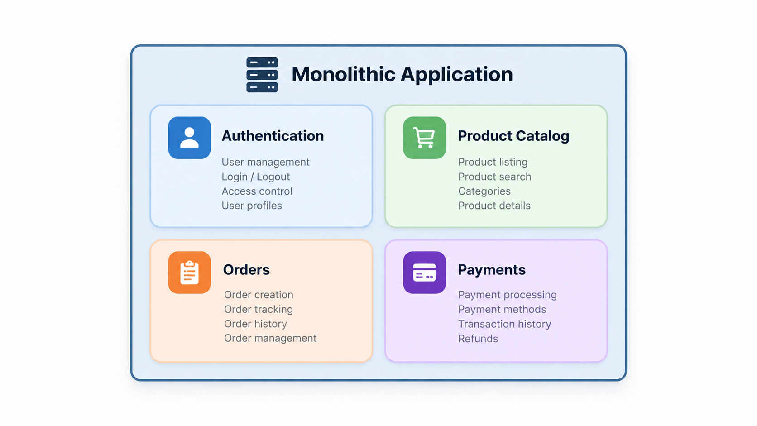
Key characteristics of Monolithic Architecture
Single deployment unit: The entire application is deployed together.
Shared execution environment: Components typically run within the same application process.
Tightly integrated components: Functional modules can communicate through direct method or function calls.
Centralized management: The application is commonly built, tested, and deployed as a whole.
Notes:
Single deployment unit: The entire application is deployed together.
Shared execution environment: Components typically run within the same application process.
Tightly integrated components: Functional modules can communicate through direct method or function calls.
Centralized management: The application is commonly built, tested, and deployed as a whole.

Slide 21
Advantages of Monolithic Architecture
All functionalities are developed within a single application, simplifying initial development and project setup.
Simple development
The entire application can be packaged and deployed as a single unit.
Easy deployment
End-to-end testing can be performed within a unified application environment.
Simplified testing
Internal components communicate through direct function or method calls, avoiding network overhead.
Efficient communication
Notes:
Imagine a small online bookstore developed by three programmers. Using a monolithic architecture allows them to implement authentication, book management, and ordering within one project, without having to manage multiple independently deployed services.

Slide 22
Limitations of Monolithic Architecture
Individual modules cannot be scaled independently when they belong to the same deployment unit.
Limited scalability
As the application grows, understanding, modifying, and maintaining its codebase becomes more difficult.
Increasing complexity
Updating a single module generally requires rebuilding and redeploying the entire application.
Deployment dependencies
A failure in one module may affect the availability or stability of the entire application.
Fault propagation
Notes:
Consider our e-commerce application during Black Friday.
The Product Catalog receives thousands of requests, while Authentication, Orders, and Payments experience normal traffic.
In a conventional monolithic deployment, scaling the application means deploying additional instances containing all four modules, even though only the Product Catalog needs extra capacity.

Slide 23
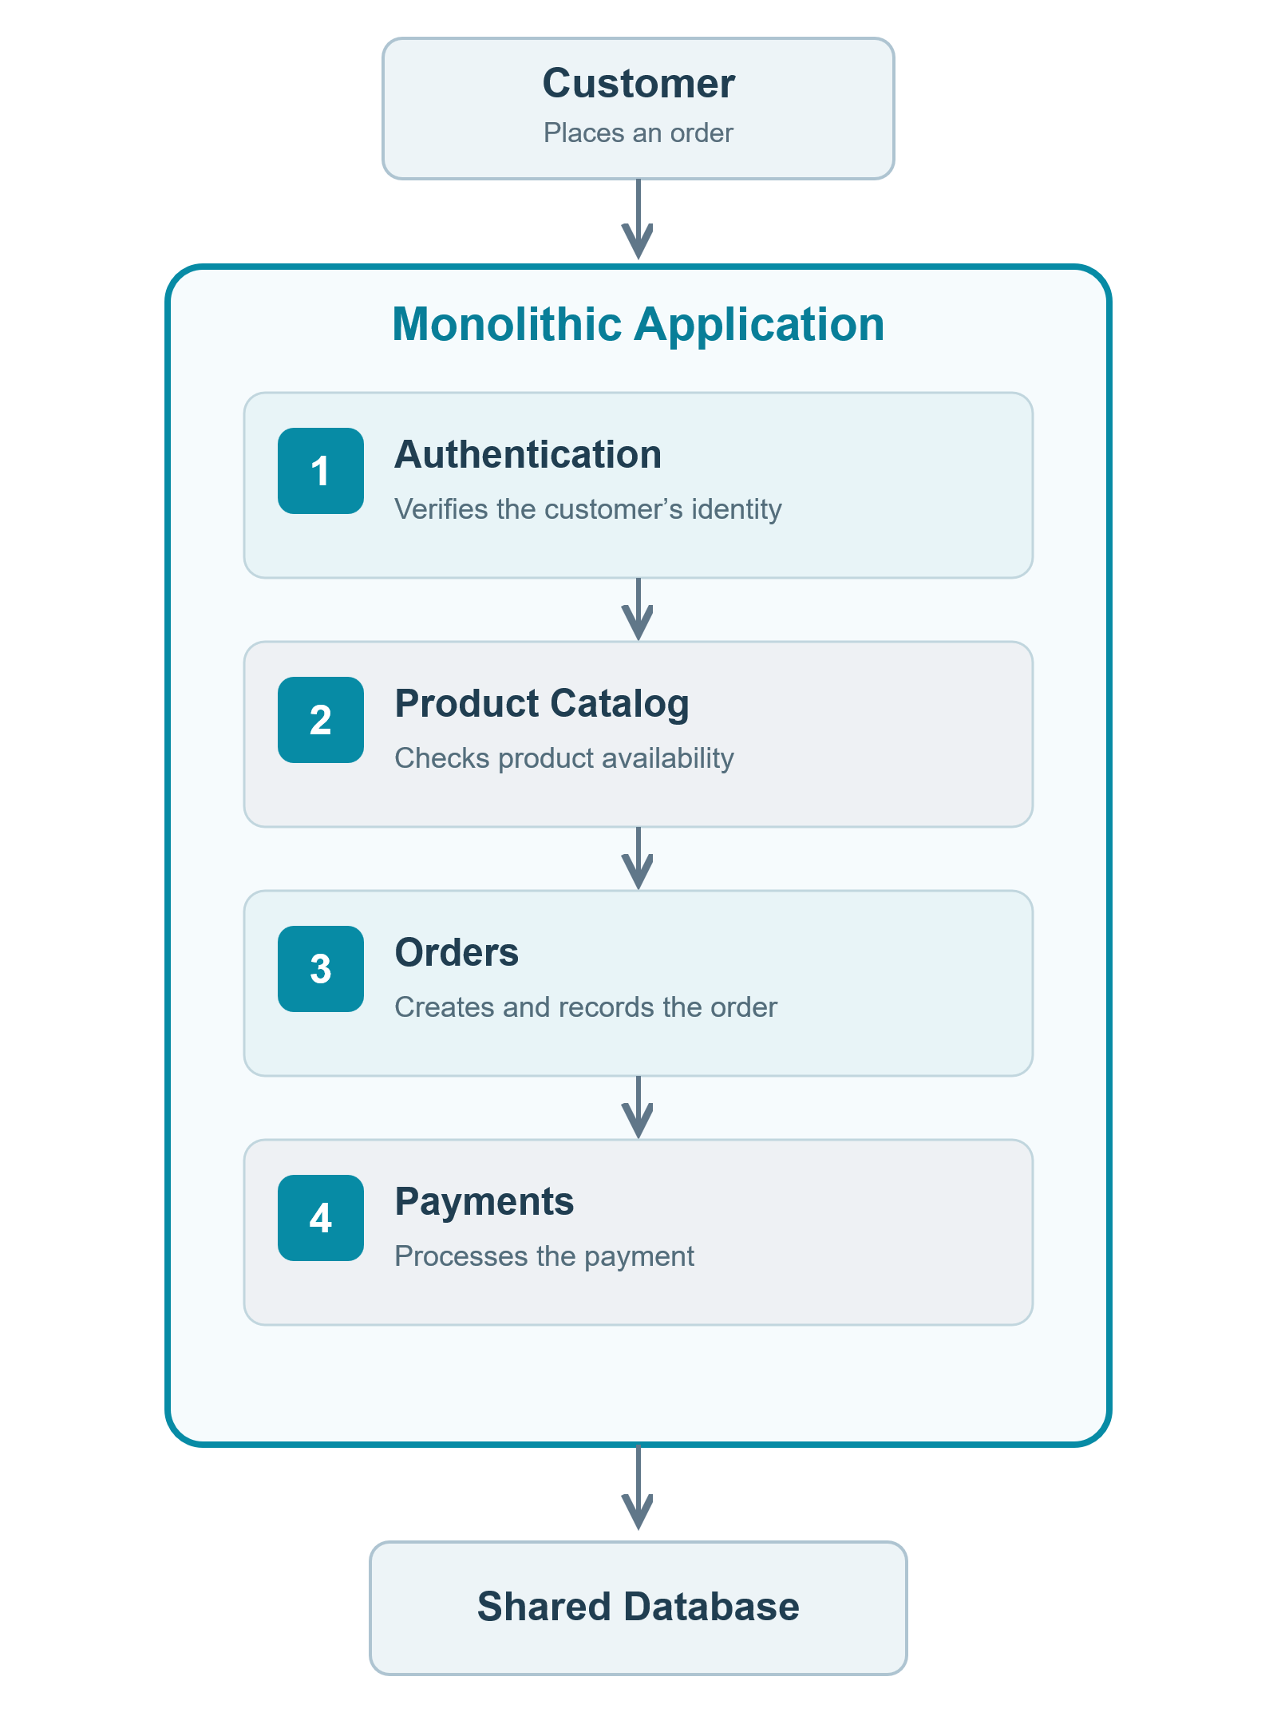
Monolithic Architecture in Practice
Example: Processing an Order
Consider an e-commerce application where customers can browse products, place orders, and complete payments.
All functionalities are implemented within a single application and share the same deployment unit.
Notes:
Key observations (for the slide)
All modules execute within the same application.
Internal communication typically occurs through direct method calls.
Modules can access a shared database.
The entire application is built and deployed as one unit.

Slide 24
Scaling a Monolithic Application
Scalability refers to a system's ability to handle increasing workloads, such as more users, requests, or transactions, by allocating additional computing resources.

Slide 25
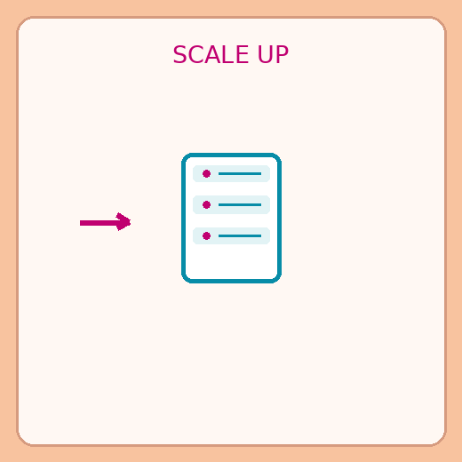
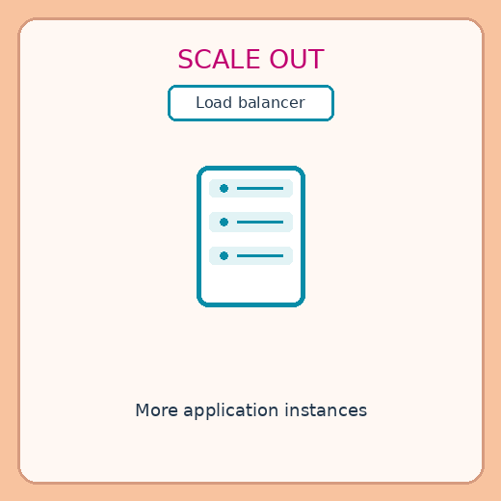
Application scaling types
Vertical Scaling (Scaling Up)
Vertical scaling consists of increasing the computing resources of an existing server.
Horizontal Scaling (Scaling Out)
Horizontal scaling consists of adding more servers or application instances to distribute the workload.
Instead of upgrading one server, we deploy multiple copies of the same monolithic application.

Slide 26
Scaling up vs. Scaling out
Aspect | Scaling up | Scaling out
Implementation | Simple to implement | Requires additional configuration
Scalability | Limited by hardware capacity | Can expand by adding servers
Cost | Powerful hardware can be expensive | Can use multiple affordable servers
Availability | Single point of failure | Redundancy improves availability
Management | Simpler infrastructure management | Requires load balancing and coordination
Data consistency | Simpler state management | Shared state requires coordination
Resource allocation | Upgrades the entire server | Capacity can be adjusted by adding or removing instances
Both approaches allow applications to handle increasing workloads.
Vertical scaling increases the capacity of an existing server, while horizontal scaling distributes the workload across multiple servers.
The choice depends on performance requirements, infrastructure costs, and system complexity.

Slide 27





When Is a Monolith the Right Choice?
Despite its limitations, monolithic architecture remains a practical and efficient choice for many software projects.
Small applications
Small development teams
Early-stage projects
Limited infrastructure
Strongly coupled operations
Limited functionalities make a unified architecture easier to develop and maintain.
Developers can collaborate within a single codebase without managing distributed services.
Simpler development and deployment allow faster prototyping and validation.
A single deployment unit reduces infrastructure and operational overhead.
Components requiring frequent interactions and atomic transactions are easier to coordinate within one application.

Slide 28



Monolithic Architecture - Key Takeaways
Unified architecture
Simplicity
A monolith combines multiple functional modules into a single deployment unit.
Monoliths offer straightforward development, testing, and deployment, particularly for smaller projects.
Scalability limitations
Architectural trade-offs
Monoliths can scale, but individual modules cannot ordinarily be scaled independently.
The appropriate architecture depends on application requirements, complexity, and available resources.

Slide 29
What happens when an application grows beyond the point where managing and deploying it as a single unit remains practical?

Slide 30
When a Monolith Becomes Difficult to Manage
Maintaining and modifying the application becomes more difficult.
Increasing complexity
Even small changes may require redeploying the entire application.
Deployment overhead
Individual components cannot be scaled independently.
Limited scalability
Introducing new technologies becomes more complicated.
Technology constraints
Different development teams must coordinate changes within the same application.
Reduced flexibility

Slide 31
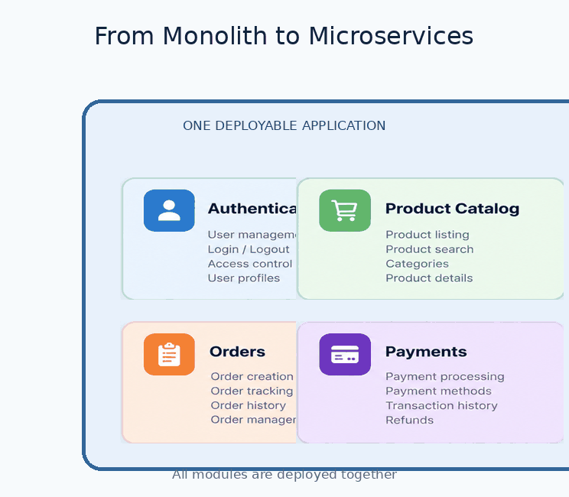
The solution
Instead of managing the application as a single unit, we can divide it into smaller, modular services.

Slide 32
Modular monolithic Architecture
03

Slide 33
Modular monoliths
A modular monolith is a software architecture in which an application is organized into well-defined, loosely coupled modules, while remaining a single deployable unit.

Slide 34
Key characteristics
Modular organization
Clear boundaries
Each module handles a specific business capability.
Modules interact through well-defined internal interfaces.
Single deployment
Simpler communication
All modules are built and deployed together.
Modules communicate within the same application process.

Slide 35
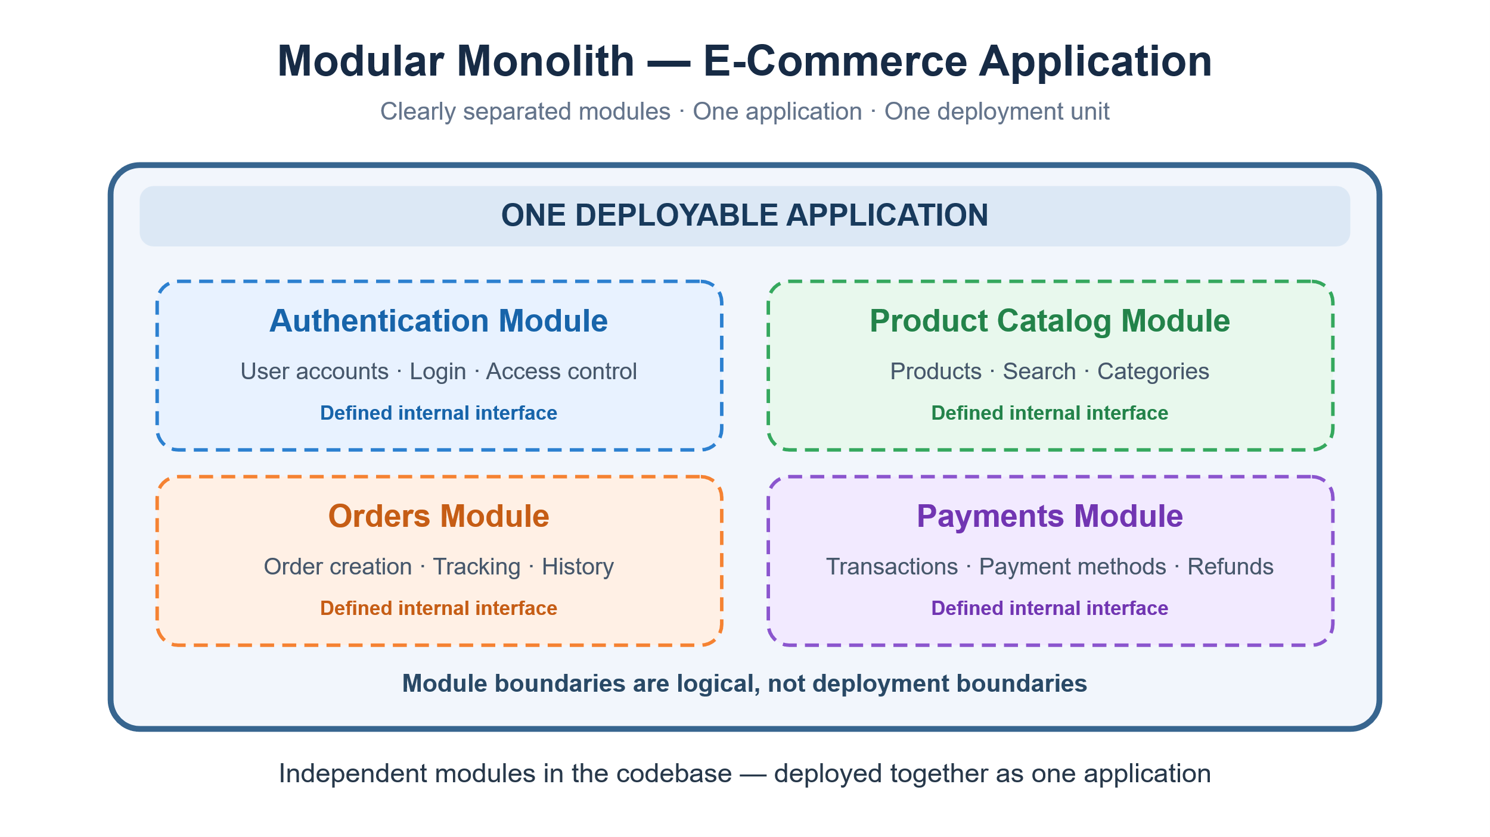
Modular monolith Architecture in Practice
Each business capability is organized into a separate module with clearly defined responsibilities and internal interfaces. However, all modules remain part of the same application and are built, deployed, and scaled together.

Slide 36
When to Choose a Modular Monolithic Architecture
Medium-sized applications
Small to medium teams
The system requires clear functional separation without distributed complexity.
Developers can work on separate modules within a shared codebase.
Evolving requirements
Simple deployment
Business boundaries are not yet stable enough to justify microservices.
A single deployable application is easier to manage and maintain.
Strong data consistency
Potential future migration
Business operations require frequent interactions and atomic transactions.
Well-defined module boundaries can facilitate extracting microservices later.

Slide 37
Microservices Architecture
04

Slide 38
Microservice architecture
Microservices Architecture is a software architectural style in which an application is organized as a collection of small, loosely coupled, and independently deployable services, each responsible for a specific business capability.
Notes:
"Remember our e-commerce application? Previously, authentication, product catalog, orders, and payments were packaged together. With microservices, we can turn these functionalities into independently deployable services. However, they still cooperate to deliver one complete application."

Slide 39
Fundamental principles
Single business responsibility
Independent deployment
Each service focuses on a well-defined business capability.
Services can be updated and deployed without redeploying the entire application.
Loose coupling
Independent scalability
Services minimize dependencies on one another.
Individual services can be scaled according to demand.
Technology flexibility
Service communication
Services can use different technologies when appropriate.
Services interact through well-defined interfaces, typically APIs or messaging.
Notes:
"Remember our e-commerce application? Previously, authentication, product catalog, orders, and payments were packaged together. With microservices, we can turn these functionalities into independently deployable services. However, they still cooperate to deliver one complete application."

Slide 40
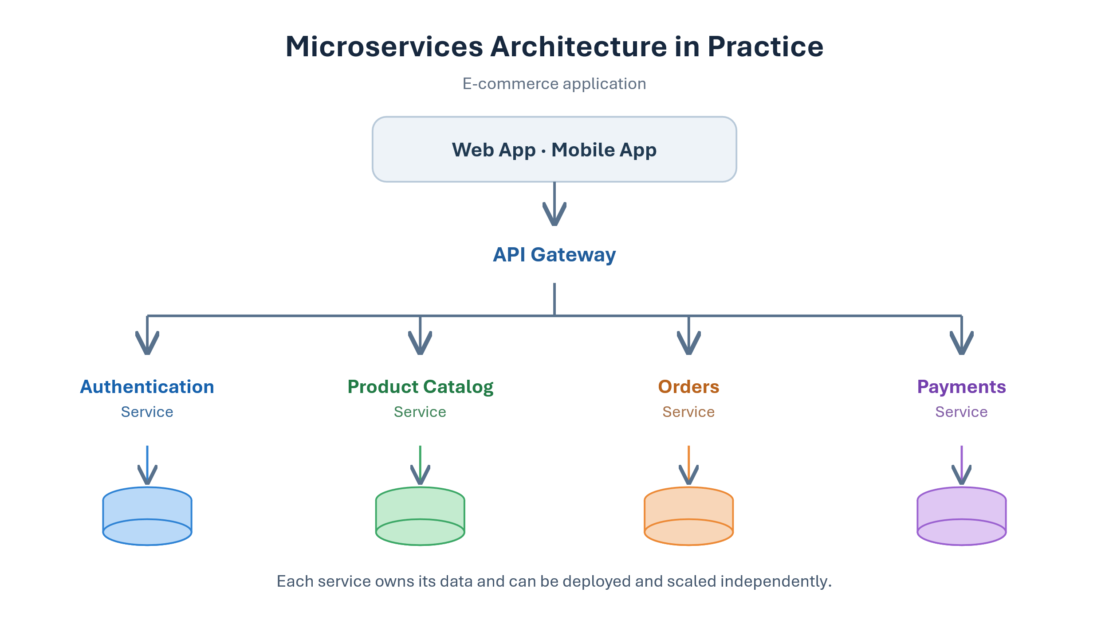
Microservices Architecture in Practice
Each service implements a specific business capability and can be developed, deployed, and scaled independently.

Slide 41
Monolithic vs Microservices Architecture
Aspect | Monolithic Architecture | Microservices Architecture
Structure | All functionalities belong to one application. | Functionalities are organized into independent services.
Deployment | Entire application deployed together. | Each service deployed independently.
Communication | Direct internal function/method calls. | Communication through APIs or messaging.
Scalability | Entire application scaled as a unit. | Individual services scaled according to demand.
Technology | Typically a shared technology stack. | Services may use different technologies.
Data management | Commonly uses a shared database. | Each service owns its data.
Fault isolation | A failure may affect the entire application. | Failures can be isolated, but may propagate across services.
Microservices provide greater deployment and scaling independence, but introduce distributed-system complexity.

Slide 42





When to Choose Microservices-Oriented Architecture
Large, complex applications
Team autonomy
Independent scalability
Technology flexibility
Mature infrastructure
Multiple business capabilities require independent management.
Different teams develop, maintain, and deploy services independently.
Services experience different workloads and scaling requirements.
Different services benefit from different technologies.
The organization can manage the complexity of distributed systems.

Slide 43



Monoliths vs. Modular Monoliths vs. Microservices
Three approaches to organizing and deploying an application.
Monolith
Modular Monolith
Microservices
Unified application
Modular, unified deployment
Distributed services
All functionalities are packaged and deployed together, often with tightly integrated components.
Functionalities are organized into well-defined modules but remain a single deployable application.
Functionalities are separated into independently deployable services communicating over a network.

Slide 44
How should an application be decomposed into independent microservices, and where should we draw the boundaries between them?

